Slide 1
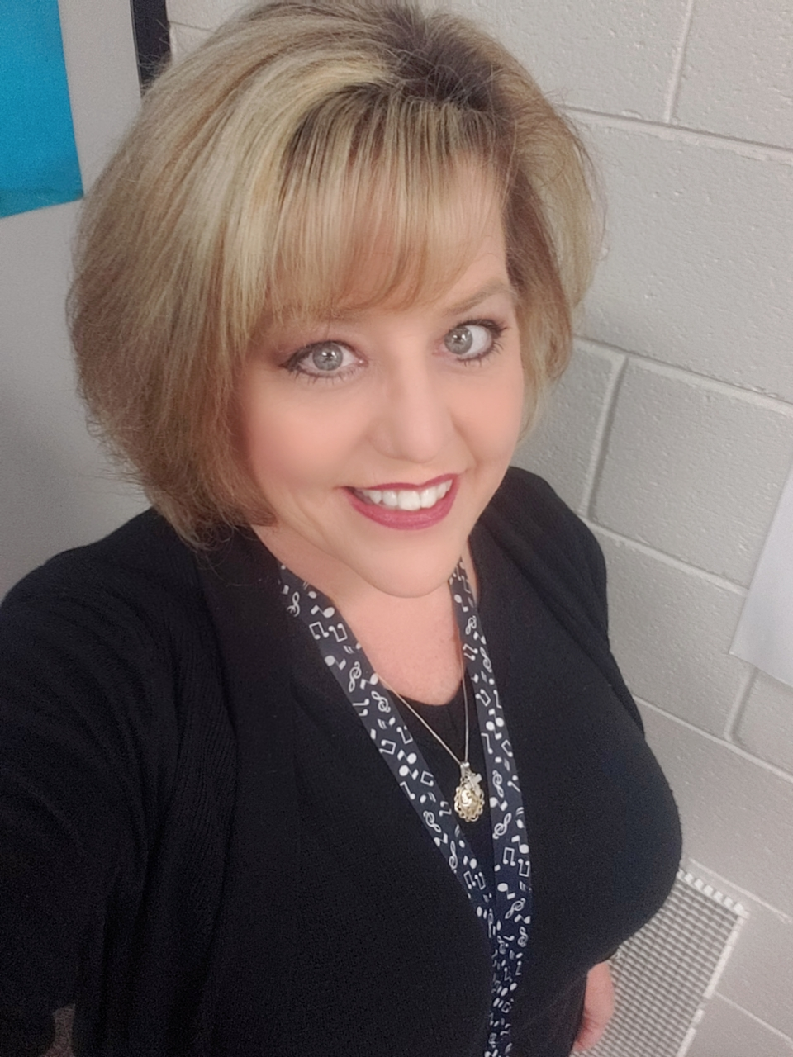

Welcome to Music
Ms. Victoria Hammond

Slide 2

Getting to know me
I have been teaching music in Richmond County since 1996. I am the mother to two amazing children that both graduated from Cross Creek. I have been blessed to be a member of the choir at Saint Paul's Episcopal Church and that has enabled me to travel all over the world as one of their soloist. As a child I loved music but until 7th grade never had a regular music class. I never intended to go to college until I had a teacher tell me that I was capable of anything I was willing to work for. Because of a positive teacher I now do what I love and my primary goal is to make sure my students know that I see them and they matter.

Slide 3

What will we do??
In my class, I want it to become your class. We will work as a team to help each other improve our knowledge not just of music but how to work together. This year there will be some challenges but if we follow some guidelines we will have a wonderful safe year.

Slide 4
Expectations and Norms
Students will be expected to keep social distance as much as possible. When we are able to sing we will do so with mask on.
I am working on individual bags for students with rhythm instruments anything that is shared will be sanitized between use.
Fourth and Fifth grade students will be given a recorder instrument to use for the year. (this will Not be shared with another student)
Virtual students will have links that I and their teacher will provide for music enrichment.

Slide 5
Make good choices use Kind words sing out
Include everyone care about others and yourself!

Slide 6
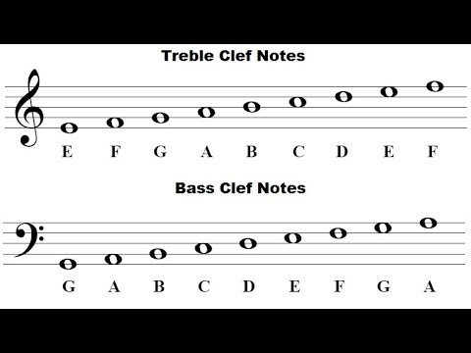
You will learn some basic notation and how to use that knowledge to create rhythms and simple songs.
Younger students will have the opportunity to discover and meet Freddy the Frog.

Slide 7


Slide 8
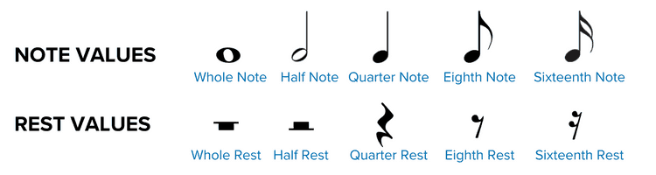
Older students will be learning and creating using basic notations that will also help them with playing the recorder.

Slide 9
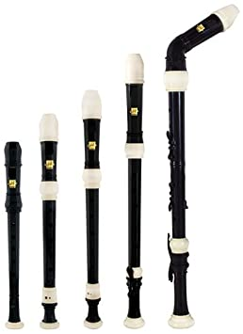

Slide 10
I Miss you all and can’t wait to see you or Meet You
Whether we are seeing each other face to face or by virtual platform, I am so glad to have you in my music class.
Music by Bobby McFerrin

